Slide 1
Identity Management
Sprint 4
Jacob Gianakopoulos, Steven Scott, Samuel Vitale, Alex Bowen, Andy Jolagh, Nick Attisha

Slide 2

Refocusing
In our previous presentations, we received feedback that our workflow was too segmented. Instead of working as a team, we were all working too individually. We were advised to pick individual components and see them through to the end. For sprint 4 we chose facial data uploading as the core component to collectively work on. All of our tasks were derived from the following user story:
As a user, I want to upload a picture to use to login.

Slide 3
Sprint 4 Tasks:
Facial Detection
Use opencv to create a python script to detect facial features in a given photo
Server Integration
Update app code to point to the server
Load the scripts onto the server
Install Python to run facial detection software
Camera Data Upload
Send data from the camera to the server.
If a face is detected, store the image and save the filepath in the database.

Slide 4
Backend Progress
Add face upload features
Take photos with built-in phone camera
Approve or delete and take another picture
Sending image files to server
Script to accept or decline based on whether a face is detected

Slide 5
Server
Installed python and the opencv package onto our server
Created the directory structure that will house user photos
Updated the app code to point at the server
Cleaned database scripts
There are still some server connectivity issues to troubleshoot

Slide 6
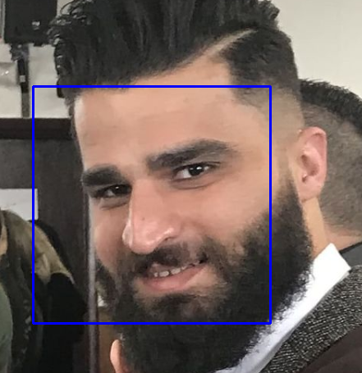
Facial Recognition Progress
Facial Detection is complete, functional, and will be shown in the demo. The recognition aspect is currently being worked on.

Slide 7
Demo

Slide 8
Future User Stories
As a user, i want to sign in with my face.
As a user, i want to sign in to a website with oauth2.
As a developer, i want a testing/demo environment for oauth2

Slide 9

Major Tasks for Next Sprint
1
2
Implement facial recognition features
Distinguish between faces instead of just detecting
Create secondary login script to login if the face matches what is on file
Upload everything and test on the server
Enable Oauth2 Functionality
Design third party sign-in view
Develop server code to generate oauth2 token
Create test environment - mock third party site

